Slide 1
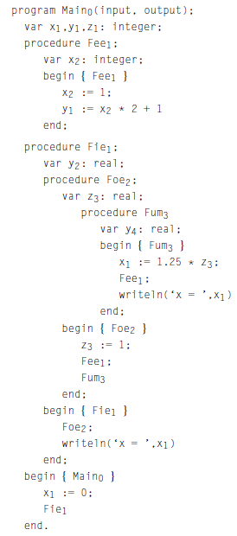
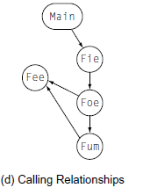
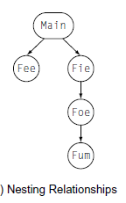
Last Lecture: The Procedure Provides Three Abstractions
External Interface
Control Abstraction
Clean Name Space

Slide 2
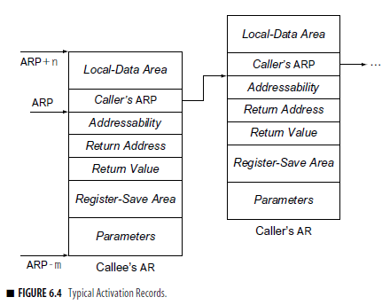
AR & ARP
To implement the twin abstractions of procedure calls and scoped name spaces, the translation must establish a set of runtime structures.
Activation Record (AR): a region of storage set aside to hold control information and data storage associated with a single instance of a single procedure. Every procedure call gives rise to a new AR
Activation record pointer (ARP)

Slide 3
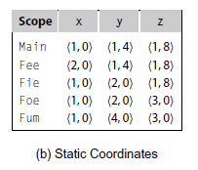
Addressability
How does the compiler find the variables?
They are at known offsets from the AR pointer
The static coordinate leads to a “loadAI” operation
Level specifies an ARP, offset is the constant

Slide 4
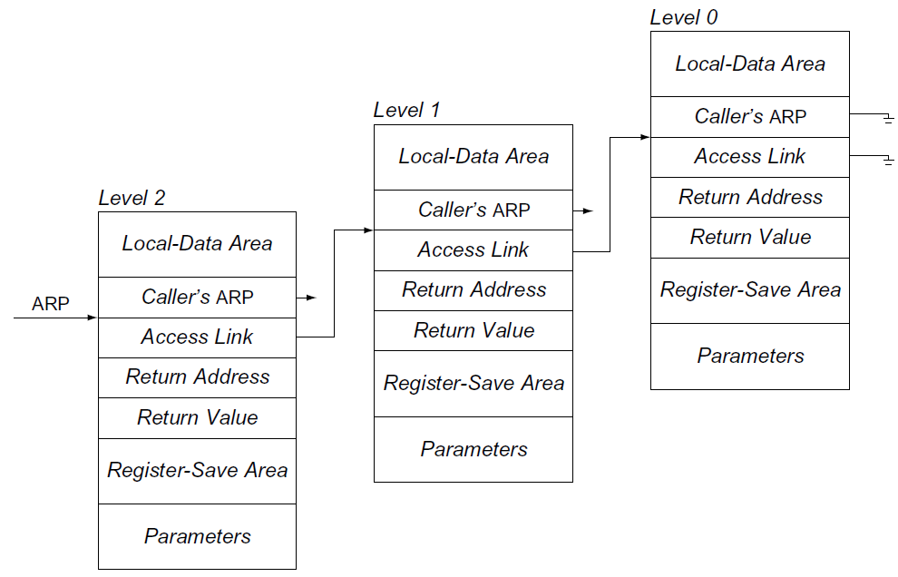
Establishing Addressability- Using Access Links
Compiler must compute base addresses for each kind of data area
Cost of access is proportional to
lexical distance
Assume
Current lexical level is 2
Access link is at ARP – 4
ARP is in r₀
SC | Generated Code
<2,8> | loadAI r₀,8 | ⇒ r₁₀
<1,12> | loadAI r₀,-4 | ⇒ r₁
 | loadAI r₁,12 | ⇒ r₁₀
<0,16> | loadAI r₀,-4 | ⇒ r₁
 | loadAI r₁,-4 | ⇒ r₁
 | loadAI r₁,16 | ⇒ r₁₀

Slide 5
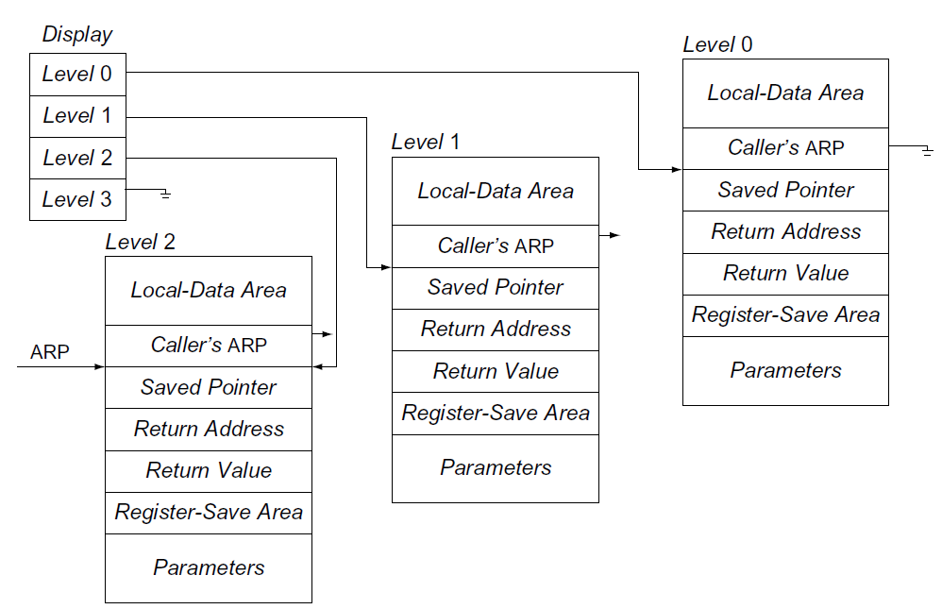
Establishing Addressability – Using a Display
Using a Display to Find an ARP for a Non-Local Variable
Global array of pointer to nameable ARs
Needed ARP is an array access away
Cost of access is constant
Assume
Current lexical level is 2
Display is at label _disp
SC | Generated Code
<2,8> | loadAI r₀,8 | ⇒ r₁₀
<1,12> | loadI _disp | ⇒ r₁
 | loadAI r₁,4 | ⇒ r₁
 | loadAI r₁,12 | ⇒ r₁₀
<0,16> | loadI _disp | ⇒ r₁
 | loadAI r₁,0 | ⇒ r₁
 | loadAI r₁,16 | ⇒ r₁₀

Slide 6
Creating and Destroying Activation Records
All three parts of the procedure abstraction leave state
in the activation record
How are ARs created and destroyed?
Procedure call must allocate & initialize (preserve caller’s world)
Return must dismantle environment (and restore caller’s world)
Caller & callee must collaborate on the problem
Caller alone knows some of the necessary state
Return address, parameter values, access to other scopes
Callee alone knows the rest
Size of local data area (with spills), registers it will use
Their collaboration takes the form of a linkage convention
Assume, for the moment, an Algol-60 environment where the activation information is dead on the return.
Notes:
Three abstractions are control abstraction, name space, external interfaces

Slide 7
Procedure Linkages
How do procedure calls actually work?
At compile time, callee may not be available for inspection
Different calls may be in different compilation units
Compiler may not know system code from user code
All calls must use the same protocol
The procedure linkage is a contract between the compiler, the operating system, and the target machine
clearly divides responsibility for naming, allocation of resources, addressability, and protection
ensures interoperability of procedures between the user’s code, and code from other sources
enforces control & data abstractions

Slide 8
Procedure Linkages
Standard Procedure Linkage
procedure p
Procedure has
standard prolog
standard epilog
Each call involves a
pre-call sequence
post-return sequence
These are completely predictable from the call site ⇒ depend on the number & type of the actual parameters
prolog
procedure q
prolog
pre-call
post-return
epilog
epilog

Slide 9
Procedure Linkages
procedure p
prolog
procedure q
prolog
Pre-call Sequence
Sets up callee’s basic AR
Helps preserve its own environment
The Details
Allocate space for the callee’s AR
except space for local variables
Evaluates each parameter & stores value or address
Saves return address, caller’s ARP into callee’s AR
If access links are used
Find appropriate lexical ancestor & copy into callee’s AR
Save any caller-save registers
Save into space in caller’s AR
Jump to address of callee’s prolog code
pre-call
post-return
epilog
epilog
The registers designated for the caller to save are caller-saves registers.
Notes:
(CW) means “conventional wisdom”

Slide 10
Procedure Linkages
Prolog Code
Finish setting up callee’s environment
Preserve parts of caller’s environment that will be disturbed
The Details
Preserve any callee-save registers
If display is being used
Save display entry for current lexical level
Store current ARP into display for current lexical level
Allocate space for local data
Easiest scenario is to extend the AR
Find any static data areas referenced in the callee
Handle any local variable initializations
With heap allocated AR, may need a separate heap object for local variables.

Slide 11
Procedure Linkages
Epilog Code
Wind up the business of the callee
Start restoring the caller’s environment
The Details
Store return value?
Some implementations do this on the return statement
Others have return assign it & epilog store it into caller’s AR
Restore callee-save registers
Free space for local data, if necessary (on the heap)
Load return address from AR
Restore caller’s ARP
Jump to the return address
If ARs are stack allocated, the “free” occurs implicitly (cheaply) when stacktop is reset to its pre-call value.

Slide 12
Procedure Linkages
Post-return Sequence
Finish restoring caller’s environment
Place any value back where it belongs
The Details
Copy return value from callee’s AR, if necessary
Free the callee’s AR
Restore any caller-save registers
Restore any call-by-reference parameters to registers, if needed
Also copy back call-by-value/result parameters
Continue execution after the call

Slide 13
Saving Registers
Who saves the registers? Caller or callee?
Conventional wisdom: divide registers into three sets
Caller saves registers
Caller targets values that are not LIVE across the call
Callee saves registers
Callee only uses these AFTER filling caller saves registers
Registers reserved for the linkage convention
ARP, return address (if in a register), …
Where are they stored? In one of the ARs …

Slide 14
Communicating Between Procedures
Most languages provide a parameter passing mechanism
Expression used at “call site” becomes variable in callee
Two common binding mechanisms
Call-by-reference passes a pointer to actual parameter
Requires slot in the AR (for address of parameter)
Multiple names (aliases) may have the same address
Call-by-value passes a copy of its value at time of call
Requires slot in the AR
Each name gets a unique location (may have same value)
call fee(x,x,x);

Slide 15
Allocating Activation Record
In the most general case, both the caller and the callee need access to the callee’s AR. Unfortunately, the caller cannot know, in general, how large the callee’s AR must be.
If activation records are stored on the stack
Easy to extend — simply bump top of stack pointer
Caller & callee share responsibility
Caller can push parameters, space for registers, return value slot, return address, addressability info, & its own ARP
Callee can push space for local variables (fixed & variable size)
If activation records are stored on the heap
Hard to extend
Several options
Caller passes everything in registers; callee allocates & fills AR
Store parameters, return address, etc., in caller’s AR !
Store callee’s AR size in a defined static constant
Algol-60 rules
ML rules

Slide 16
Chapter 7 Code Shape

Slide 17
Code Shape
The concept of “code shape” encapsulates all of the decisions, large and small, that the compiler writer makes about how to represent the computation in both IR and assembly code.
Code shape has a strong impact on the
behavior of the compiled code
ability of the optimizer and back end to improve it
Rule of thumb: expose as much derived information as possible

Slide 18
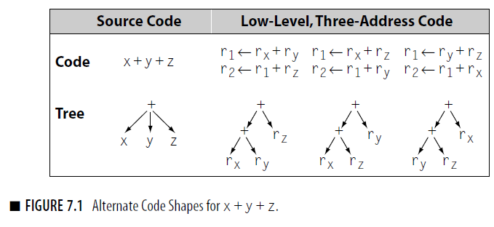
Code Shape
Code shape example: ways to implement the expression
The “best” shape for x+y+z depends on contextual knowledge
There may be several conflicting options

Slide 19
Code Shape
Another example -- the case statement
Implement it as cascaded if-then-else statements
Cost depends on where your case actually occurs
O(number of cases)
Implement it as a binary search
Need a dense set of conditions to search
Uniform (log n) cost
Implement it as a jump table
Lookup address in a table & jump to it
Uniform (constant) cost
Compiler must choose best implementation strategy
Performance depends on order of cases in the final code ⇒ compiler should reorder based on frequency!

Slide 20
Code Shape
Why worry about code shape? Can’t we just trust the optimizer and the back end?
It often pays to encode useful information into the IR
Deriving such information may be expensive, when possible, recording it explicitly in the IR which is often easier and cheaper
Optimizer and back end approximate the answers to many hard problems
This chapter explores the code-shape issues that arise in implementing many common source-language constructs. It focuses on the code that should be generated for specific constructs, while largely ignoring the algorithms required to pick specific assembly-language instructions.

Slide 21
Placing Runtime Data Structures
The compiler, the operating system, and the processor cooperate to ensure that multiple programs can execute safely on an interleaved (time-sliced) basis.
Many of the decisions about how to lay out, manipulate, and manage a program’s address space lie outside the purview of the compiler writer.
However, the decisions have a strong impact on the code that the compiler generates. Thus, the compiler writer must have a broad understanding of these issues.

Slide 22
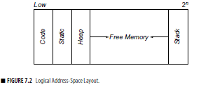
Placing Run-time Data Structures
Classic Organization
C
o
d
e
S G
t l
a & o
t b
i a
c l
S
t
a
c
k
H
e
a
p
0
high
Better utilization if stack & heap grow toward each other
Single Logical Address Space
Code, static, & global data have known size
Heap & stack both grow & shrink over time
This is a virtual address space , not allocated memory
From the compiler’s perspective, this logical address space is the whole picture.
However, modern computer systems typically execute many programs in an interleaved fashion. The operating system maps multiple logical address spaces into the single physical address space supported by the processor.

Slide 23
How Does This Really Work?
The Big Picture
virtual address spaces
Compiler’s view
C
o
d
e
S G
t l
a & o
t b
i a
c l
S
t
a
c
k
H
e
a
p
C
o
d
e
S G
t l
a & o
t b
i a
c l
S
t
a
c
k
H
e
a
p
C
o
d
e
S G
t l
a & o
t b
i a
c l
S
t
a
c
k
H
e
a
p
C
o
d
e
S G
t l
a & o
t b
i a
c l
S
t
a
c
k
H
e
a
p
...
OS’ view
...
0
high
1980 Hardware view
Physical address space_
On many modern processors, L1 cache uses physical addresses
Higher level caches typically use virtual addresses

Slide 24
How Does This Really Work?
Most systems now include L3 caches. L4 is on its way.
Of course, the “Hardware view” is no longer that simple
Main
Memory
...
0
high
...
Caches can use physical or virtual addresses
Caches can be inclusive or exclusive
Caches can be shared
L2 Cache
L1 Caches
Code
Data
Code
Data
Functional unit
Functional unit
Functional unit
Functional unit
Processor Cores
Functional unit
Functional unit
Functional unit
Functional unit
Cache structure matters for performance, not correctness
Notes:
And this picture does not show the TLBs — core private or shared among cores — in multiple levels.

Slide 25
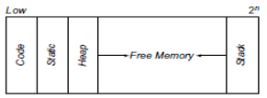
Layout for Data Areas
The compiler groups together the storage for values with the same lifetimes and visibility; it creates distinct data areas for them.
The placement of these data areas depends on language rules about lifetimes and visibility of values.
If lifetime of data area matches procedure invocation AND if procedures normally return then
Stack them with control information (Activation Record)
If lifetime of data area is entire execution then
Allocate space for data area statically (assembler directive)
If lifetime of data is less than entire execution BUT longer than procedure invocation then
Allocate space for data area on the heap

Slide 26
Assigning offsets
The compiler needs to assign offsets to each variable kept in RAM
For each local, static, and global data areas, the compiler must assign each name an offset inside the data area.
Order them by alignment constraints and assign most constrained objects first (e.g., double-word, then word, then half-word, then byte, …)
Reduce padding needed to maintain alignment

Slide 27
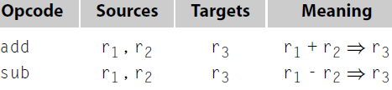


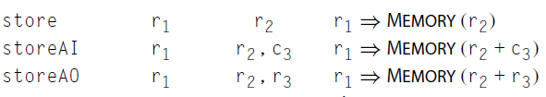
Intermediate Language
ILOC—"intermediate language for an optimizing compiler
Three-address code
…

Slide 28
Code for Expressions
The desired three-address code is simple
Basic paradigm is simple
Get the two operands into registers
Issue the operation with its result going into a register
Assume unlimited registers (before allocation)

Slide 29
Generating 3-Address Code
Trivial expression: a + b
The compiler first emits code to ensure that the values of a and b are in registers, say r_{a} and r_{b}.
If a is stored in memory at offset @a in the current AR, and b is stored in memory at offset @b in the current AR, the resulting code might be
loadI @a r₁
loadAO r_{arp} r₁ r_{a}
loadI @b r₂
loadAO r_{arp} r₂ r_{b}
Then it emits an instruction to perform the addition, such as
add r_{a}, r_{b} r_{t}
If, however, the value of a is already in a register, the compiler can simply use that register in place of r_{a}.
local
variables
ARP
caller’s ARP
addressability
return address
return value
register
save area
parameters

Slide 30
Generating 3-Address Code from a Tree
+
The Concept
Assume an AST as input and ILOC as output
AST is a contraction of the parse tree that omits most nodes for nonterminal symbols
Use a postorder treewalk evaluator
Visits & evaluates children
Emits code for the op itself
Returns register with result
x
y
−
x
×
2
y

Slide 31
Generating 3-Address Code from a Tree
expr(node) {
int result, t1, t2;
switch (type(node)) {
case ×,÷,+,− :
t1← expr(left child(node));
t2← expr(right child(node));
result ← NextRegister();
emit (op(node), t1, t2, result);
break;
case IDENTIFIER:
t1← base(node);
t2← offset(node);
result ← NextRegister();
emit (loadAO, t1, t2, result);
break;
case NUMBER:
result ← NextRegister();
emit (loadI, val(node), none, result);
break;
}
return result;
}
The base routine returns the name of a register holding the base address for an identifier; if needed, it emits code to get that address into a register.
The offset routine has a similar function; it returns the name of a register holding the identifier’s offset relative to the address returned by base.
Val gets a number into a register and returns the name of a register
Notes:
Base( an IDENTIFIER node ) looks up the node’s symbol in the table, finds its base address, and gets that address in a register.
It can, in a decent implementation, know that &_procname.static_ is already in a register and avoid the load.
Offset( an IDENTIFIER node ) looks up the node’s symbol in the table, places its offset in a register, & returns that register.
Val( a NUMBER node ) gets that number into a register & returns it.

Slide 32
Generating Code for Expressions
expr(node) {
int result, t1, t2;
switch (type(node)) {
case ×,÷,+,− :
t1← expr(left child(node));
t2← expr(right child(node));
result ← NextRegister();
emit (op(node), t1, t2, result);
break;
case IDENTIFIER:
t1← base(node);
t2← offset(node);
result ← NextRegister();
emit (loadAO, t1, t2, result);
break;
case NUMBER:
result ← NextRegister();
emit (loadI, val(node), none, result);
break;
}
return result;
}
Example:
Produces:
+
x
y
expr(“x”) →
loadI | @x | ⇒ r1
loadAO | r_{arp},r1 | ⇒ r2
expr(“y”) →
loadI | @y | ⇒ r3
loadAO | r_{arp},r3 | ⇒ r4
NextRegister() → r5
Emit(add,r2,r4,r5) →
add | r2,r4 | ⇒ r5

Slide 33
Generating Code for Expressions
expr(node) {
int result, t1, t2;
switch (type(node)) {
case ×,÷,+,− :
t1← expr(left child(node));
t2← expr(right child(node));
result ← NextRegister();
emit (op(node), t1, t2, result);
break;
case IDENTIFIER:
t1← base(node);
t2← offset(node);
result ← NextRegister();
emit (loadAO, t1, t2, result);
break;
case NUMBER:
result ← NextRegister();
emit (loadI, val(node), none, result);
break;
}
return result;
}
Example:
Produces:
−
x
×
2
y
loadI | @x | ⇒ r1
loadAO | r_{arp},r1 | ⇒ r2
loadI | 2 | ⇒ r3
loadI | @y | ⇒ r4
loadAO | r_{arp},r4 | ⇒ r5
mult | r3,r5 | ⇒ r6
sub | R2,r6 | ⇒ r7

Slide 34
Code Shape & Instruction Scheduling
Evaluation Order
Consider “a + b + c + d + e + f + g + h”
+
+
h
t₁ ← a + b
t₂ ← t₁ + c
t₃ ← t₂ + d
t₄ ← t₃ + e
t₅ ← t₄ + f
t₆ ← t₅ + g
t₇ ← t₆ + h
+
g
Sequential dependences constrain execution order
+
f
+
e
+
d
+
c
a
b
Left-associative tree
Corresponding code
Left-recursive expression grammar (e.g., LR parser) would produce a left-associative tree

Slide 35
Code Shape & Instruction Scheduling
Evaluation Order
Consider “a + b + c + d + e + f + g + h”
t₁ ← a + b
t₂ ← c + d
t₃ ← e + f
t₄ ← g + h
t₅ ← t₁ + t₂
t₆ ← t₃ + t₄
t₇ ← t₅ + t₆
+
Sequential dependences are much more relaxed
+
+
+
+
+
+
a
b
c
d
e
f
g
h
Balanced tree
Corresponding code
No rational parser will produce this tree.
In fact, a post-optimization, pre-scheduling pass makes sense.

Slide 36
Code Shape & Instruction Scheduling
Evaluation Order
Balanced Tree |  |  |  | Left-Associative Tree
 | Unit 0 | Unit 1 |  |  | Unit 0 | Unit 1
1 | t₁ ← a + b | t₂ ← c + d |  | 1 | t₁ ← a + b | ⎯
2 | t₃ ← e + f | t₄ ← g + h |  | 2 | t₂ ← t₁ + c | ⎯
3 | t₅ ← t₁ + t₂ | t₆ ← t₃ + t₄ |  | 3 | t₃ ← t₂ + d | ⎯
4 | t₇ ← t₅ + t₆ | ⎯ |  | 4 | t₄ ← t₃ + e | ⎯
5 |  |  |  | 5 | t₅ ← t₄ + f | ⎯
6 |  |  |  | 6 | t₆ ← t₅ + g | ⎯
7 |  |  |  | 7 | t₇ ← t₆ + h | ⎯
Free for other work
Schedules for Balanced Tree versus Left-Associative Tree
Assumes two functional units

Slide 37
Code for Expressions
The compiler needs to decide which values can live in registers
A value is ambiguous if the compiler can access it via more than one name
Some pointer based values
Some call-by-reference parameters
Most compilers treat array elements (e.g., A[i,j]) as ambiguous
Any unambiguous value is a candidate for a register
Ambiguous values must live in memory (load or store at each access)

Slide 38
Handling Assignment
Handle assignment as an operator: lhs ← rhs
Strategy
Evaluate rhs to a value (an rvalue)
Evaluate lhs to a location (an lvalue)
lvalue is a register ⇒ move rhs
lvalue is an address ⇒ store rhs
If rvalue & lvalue have different types
Evaluate rvalue to its “natural” type
Convert that value to the type of *lvalue
Unambiguous scalars go into registers
Ambiguous scalars or aggregates go into memory

Slide 39
Code for Assignment
a = a + 2 - b + c
loadAI r_{arp}, @a r_{a} // load ‘a’
loadAI r_{arp}, @b r_{b} // load ‘b’
loadAI r_{arp}, @c r_{c} // load ‘c’
addI r_{a}, 2 r_{a} // r_{a} <- a + 2
sub r_{a}, r_{b} r_{a} // r_{a} <- a + 2 - b
add r_{a}, r_{c} r_{a} // r_{a} <- a + 2 – b + c
storeAI r_{a} r_{arp}, @a // write r_{a} back to ‘a’
Alternatively
loadAI r_{arp}, @a r_{a} // load ‘a’
loadI 2 r2
loadAI r_{arp}, @b r_{b} // load ‘b’
loadAI r_{arp}, @c rc // load ‘c’
add r_{a}, r2 r_{a} // r_{a} <- a + 2
sub r_{a}, r_{b} r_{a} // r_{a} <- a + 2 - b
add r_{a}, r_{c} r_{a} // r_{a} <- a + 2 – b + c
storeAI r_{a} r_{arp}, @a // write ra back to ‘a’

